Slide 1

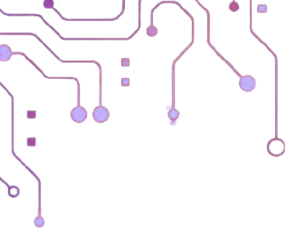




SECURING FEDERATED LEARNING ENVIRONMENTS
FACULTY OF ARTIFICIAL INTELLIGENCE ENGINEERING INTELLIGENT INFORMATION SECURITY SYSTEMS ENGINEERING
Against Coordinated Data Poisoning Attacks
Pre-Graduation Project 1
2026 - 2027
Prepared by:
Maryam Yaser AlAsmi Maya Hesham Daghestani
Supervised by :
Dr. Mohammed Alchaita Eng.Ahmad Shekha

Slide 2
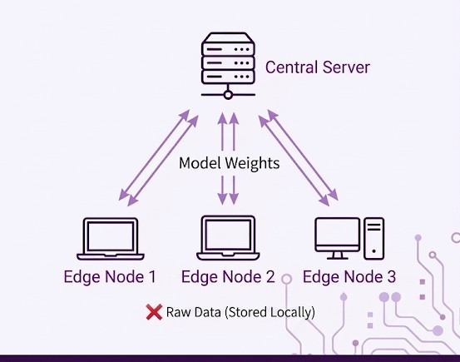



Fundamental Concepts & Architecture :
10/2
Central Server
Aggregates the global model updates.
Edge Nodes
Distributed clients training models locally.
Weights Exchange
Sharing parameters, keeping data local.
The "Blind" Server
Receives updates, never raw data.
Raw Data (Stored Locally)

Slide 3



Ref.
Technical Contribution
Research Gap
10/3
[ 1 ]
Detects collaborative attackers via Euclidean distance analysis and dynamic clique formation.
Software-Level Only: Ignores malicious updates but fails to isolate the attacker from the network.
Lack of Root Mitigation: Shows defenses fail in Non-IID settings and cannot disconnect compromised nodes.
Temporal Algorithmic Flaws: Filtering decays over time, highlighting the critical need for Proactive Network Isolation.
No Active Deterrence: Lacks a mechanism to physically evict or isolate persistently malicious nodes.
[ 2 ]
Comprehensive benchmarking of poisoning attacks and robust aggregation defenses in FL.
Proves bypass of standard defenses (Krum, Median) via multi-round consistency of malicious updates.
[ 3 ]
Integrates Homomorphic Encryption (FHE) with anomaly detection to secure models against poisoning.
[ 4 ]
Systematic review of defense architectures and robust aggregation in large-scale enterprise systems.
Systematic review of defense architectures and robust aggregation in large-scale enterprise systems. 12/05
[ 5 ]

Slide 4
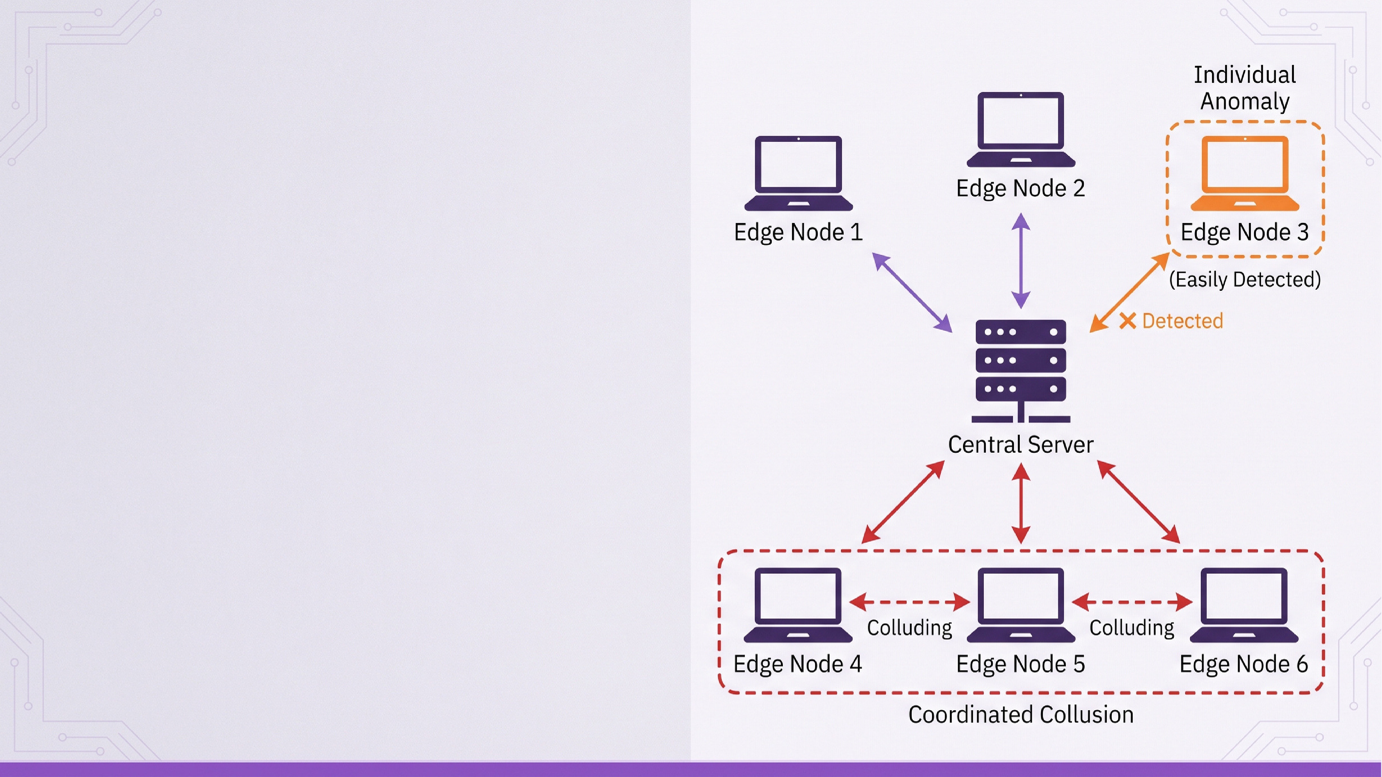
Vulnerabilities & Problem Statement :
10/4
Vulnerabilities & Problem Statement:
12/04
The "Blind" Aggregator Challenge
Cannot verify local data integrity
The Sneaky Collusion
Cooperating nodes bypass standard detection.
Software-Level Mitigation Gaps
Attackers stay connected, draining resources

Slide 5

10/5
Proposed Solution &Automated Isolation :
1- Detection Algorithm: CBDF Framework
Detecting colluding malicious nodes via clique analysis
Network isolated
²⁻ Proposed Solution :
Automated Network-Level Isolation
Instantly cutting off attackers using server firewalls
3- Final Outcome: Resource & Integrity Protection
Securing global models and preventing resource exhaustion

Slide 6


Expected Outcomes:
10/6
Secure FL against synchronized insider threats.
Automated real-time isolation of malicious nodes.

Slide 7

Project Roadmap
10/7
(Pre-Grad 1)
Netwrok Foundation & Protocol Configuration
Federated Learning Setup & Attack Simulation
(Graduation 1)
(Graduation 2)
Detection Implementation & Automated Isolation

Slide 8
10/8
Gantt chart:

Slide 9
Tools & Technologies
10/9
Core & ML
Python: Federated Learning & CBDF logic VMware: Multi-node network simulation Ubuntu Linux: Server and edge node OS
Network & Security
Snort 3: Network anomaly detection
IPTables / UFW: Automated firewall isolation
Flask / REST APIs: Client-server
communication

Slide 10


References :
10/10
[1] Anastasiadis, D. et al., "Defending FL from Collaborative Poisoning Attacks: A Clique-Based Detection Framework", Electronics, (2025).
[2] Zhang, H. et al., "SoK: Benchmarking Poisoning Attacks and Defenses in Federated Learning", arXiv, (2025).
[3] Xie, Y. et al., "Model Poisoning Attacks to FL via Multi-Round Consistency", arXiv, (2024).
[4] Xu, R. et al., "Dual Defense: Enhancing Privacy and Mitigating Poisoning Attacks in FL", NeurIPS, (2024).
[5] Hasan, M. M., "FL Models for Privacy-Preserving AI in Enterprise Decision Systems", IJBEI, (2025).

